Slide 1
2CEIT502 Software Engineering
GANPAT UNIVERSITY
U. V. PATEL COLLEGE OF ENGINEERING
Unit 2
Process Models
(Software Development Life Cycle)
Prepared by: Prof. Ravi Raval (Asst. Prof in C.E Dept. , UVPCE)

Slide 2
Unit 2: Process Models
Contents:
What is software process?
What is SDLC?
Prescriptive Models
The Waterfall model
Incremental process models
Evolutionary Process Models
Comparisons of Models
Selection of model for development
The Unified process

Slide 3
Unit 2: Process Models
What is software Process?
A process is a collection of activities, actions and tasks that are performed when some work product is to be created.
Activity: An activity strives to achieve a broad objective (e.g communication with stake holders) and is applied regardless of the application domain, size of the project, complexity of the effort, or degree of rigor with which software engineering is to be applied.
Action: An action (e.g. an architecture design model) encompasses a set of tasks that produce a major product.
Task: A task focuses on small, but well-defined objective (e.g. conducting a unit test) that produces a tangible outcome.

Slide 4
Unit 2: Process Models
Five activities under process framework:
Communication
Planning
Modeling
Construction
Deployment
Software engineering process framework activities are complemented by a number of umbrella activities.
Software project tracking and control.
Risk Management
Software quality Assurance
Technical Reviews
Measurement
Software configuration management
Reusability management
Work product preparation and production

Slide 5
Unit 2: Process Models
What is software development life cycle (SDLC)?
SDLC used to facilitate the development of a large software product in a systematic, well-defined and cost-effective way.
Why to follow SDLC?
Helps to understand the entire process.
Enhances a structured approach to development.
Enables planning of resources in advance.
Enables subsequent controls in advance.
Aids management to track progress of the system.
Apart from that
Entry criteria and exit criteria has to be specified.
Any model must have atleast 5 phases and atmost 9 phases.

Slide 6
Unit 2: Process Models
So, on an average, any SDLC model can have 7 to 8 phases. These are:
Project initiation and planning OR Recognition of need OR Preliminary Investigation.
Project identification and Selection OR Feasibility Study
Project analysis
System Design
Coding
Testing
Implementation
Maintenance.

Slide 7
Unit 2: Process Models
Now let’s explore each phase one by one.
Identify, understand and describe problem fully.
Feasibility study types:
Organizational feasibility: How well the proposed system supports the strategic objectives of the organization.
Technical Feasibility: Hardware, software and network capability, reliability and availability
Economic Feasibility: Cost saving, Increased revenue, decreased investment, increased profits
Operational Feasibility: End user acceptance, management support, customer-supplier and government requirements.
Project analysis
System Design
Coding
Testing
Implementation
Maintenance: Corrective maintenance, Adaptive maintenance, Perfective Maintenance, Preventive Maintenance

Slide 8
Unit 2: Process Models
Prescriptive Process Models
Prescriptive Process Models
The Waterfall Model
Incremental Process Model
Evolutionary Process Models
The V-Model
Prototyping Model
Spiral Models

Slide 9

Unit 2: Process Models
Prescriptive Process Models:
(1) Waterfall Model

Slide 10
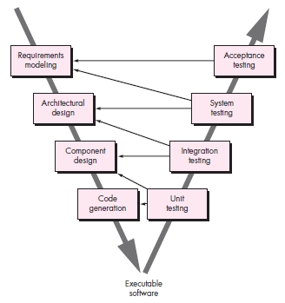
Unit 2: Process Models
Prescriptive Process Models:
(1) The V Model (variation of waterfall)
Advantages: | This model is not suitable for accommodating any change.
It is a linear Model | A working version of the system of is not seen until late in the project’s life
It is a segmental model | It does not scale up well to large project
It is systematic and sequential | It involves heavy documentation. Documentation requires at end of each phase.
It is simple one to understand and follow | We cannot go in the backward direction while SDLC performs
It has proper documentations. | There is no sample model for clearly in realization the customers needs.
Disadvantages: | There is no risk analysis
It’s difficult to define all requirements at the beginning of a project. | If there is any mistake or error in any phase then it will propagate to the last

Slide 11
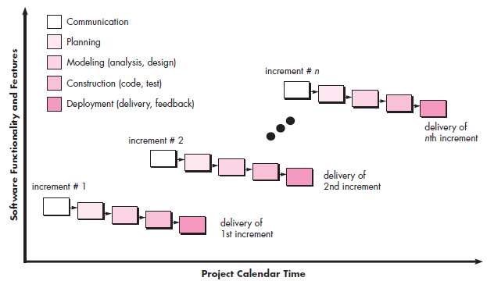
Unit 2: Process Models
Prescriptive Process Models:
(2) Incremental Process Model
Each linear sequence produces
Deliverable “increment” of SW
For ex. Word Processing SW
1st Increment: Basic file
Management
2nd Increment: More sophisticated
Editing & document production capability
3rd Increment: Spelling and grammar
checking
4th Increment: Advanced page layout capability
C
B
B
A
A
A

Slide 12
Unit 2: Process Models
Prescriptive Process Models:
(2) Incremental Process Model
Advantages:
The feedbacks from early increments improve the later stages.
The possibility of changes in requirement is reduced because of the shorter time span between the design of a component and its delivery.
Users get benefits earlier than with a conventional approach. Early delivery of some useful components improves cash flow, because you get some return on investment early on.
Smaller sub-projects are easier to control and manage.
Gold plating, that is the requesting of features that are unnecessary and not in fact used is less as uses will know that they get more than one bite of cherry if a feature is not in the current increment then it can be included in the next.
The project can be temporarily abandoned if more urgent work crops up.
Job satisfaction is increased for developers who see their labours bearing fruit at regular, short intervals

Slide 13
Unit 2: Process Models
Prescriptive Process Models:
(2) Incremental Process Model
Disadvantages:
Software breakage, that is, later increment may requirement modification to earlier increments.
Programmer may be more productive working on one large system than on a series of smaller ones.
Some problems are difficult to divide into functional units (modules), which can be incrementally develop and delivered.
Testing of modules result into overhead and increased cost.

Slide 14
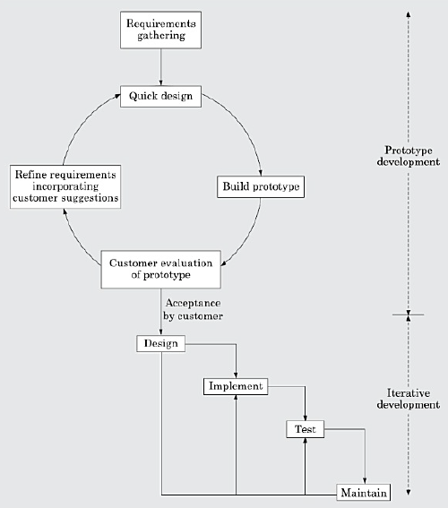
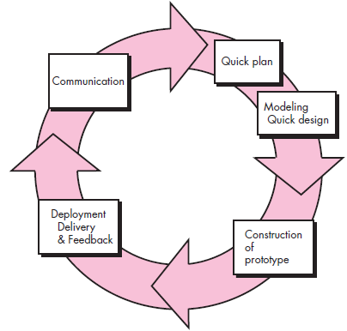
Unit 2: Process Models
Evolutionary Process Models:
(3) Prototype Model:

Slide 15
Unit 2: Process Models
Evolutionary Process Models:
(3) Prototype Model:
Advantages:
Suitable for large system for which there is no manual process to define the requirements
Prototyping make requirements more clear and system more transparent.
Flexibility in design and development is also supported by the model.
System training
Quality of software is good
User training to use the system.
User services determination
Disadvantages:
The developer often compromises in order to get working prototype quickly. (use of inappropriate OS, algorithms AND/OR programming technology)
End users may not like to know the difference between a prototype and a well-engineered fully developed product.
If not managed properly, the interactive process of prototype demonstration and refinement can continue for long duration.
If end user is not satisfied with initial prototype, he may loose interest in the project.

Slide 16
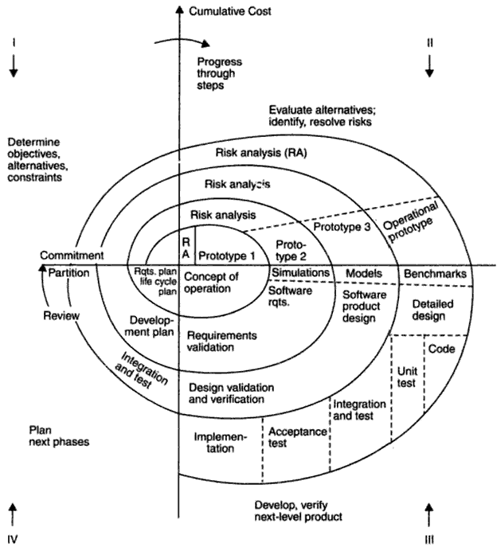
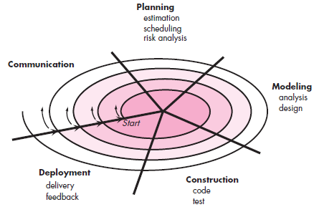
Unit 2: Process Models
Evolutionary Process Models:
(4) Spiral Model:

Slide 17
Unit 2: Process Models
Evolutionary Process Models:
(4) Spiral Model:
Advantages | Disadvantages
It is a risk driven model | No Strict standards for software development
It’s very flexible | No particular beginning or end of particular phase
Less documentation is needed | Different people may find it complex to use
It makes a use of prototyping | Requires expertise risk management & excellent management skills
It is more realistic model for software development. | Not suitable for small project. Sometimes the cost of risk analysis may exceed the actual cost of the project

Slide 18
Unit 2: Process Models
Comparisons of all models:
 | Strength | Weakness | Types of Project
Waterfall Model | Simple Easy to execute Intuitive and logical | All or nothing approach Requirements frozen early Disallows changes Cycle time too long May choose outdated hardware technology User feedback not allowed Encourages requirement bloating | For well understood problems Short duration project Automation of existing manual systems.
Prototyping Model | Helps in requirement elicitation Reduces risk Leads to a better system | Front heavy process Possibly higher cost Disallows later changes | System with novice users Best for uncertain requirements

Slide 19
Unit 2: Process Models
Comparisons of all models:
 | Strength | Weakness | Types of Project
Iterative / Incremental Model | Regular/Quick deliveries Reduces risk Accommodates changes Allows user feedback Allows reasonable exit points Avoids req. bloating Prioritizes requirements | Each iteration can have planning overhead Cost may increase as work done in one iteration may have to be undone later. System architecture and structure may suffer as frequent changes are made | For businesses where time is of essence Where risk of long project cannot be taken Where requirements are not known
Spiral Model | Controls project risks Very flexible Less documentation needed | No strict standards for software development No particular beginning or end of particular phase | Project built on untested assumptions

Slide 20
Unit 2: Process Models
Selection of a life cycle model:
How to chose a model for a given software to be developed?
Selection of model based on characteristics of requirement
Requirements | Waterfall | Prototype | Iterative | Spiral
Are requirements easily understandable and defined? | Yes | No | No | No
Do we change requirements quite often? | No | Yes | No | Yes
Can we define requirements early in the cycle? | Yes | No | Yes | No
Requirements are indicating a complex system to be built | No | Yes | Yes | Yes
Selection based on Status of development team
Less Experience on similar projects | No | Yes | No | Yes
Less domain knowledge (new to technology) | Yes | No | Yes | Yes
Less experience on tools to be used | Yes | No | No | Yes
Availability of training | No | No | Yes | No

Slide 21
Unit 2: Process Models
Selection of a life cycle model:
How to chose a model for a given software to be developed?
Selection based on Users participation
Requirements | Waterfall | Prototype | Iterative | Spiral
Users involvement in all phases | No | Yes | No | No
Limited users participation | Yes | No | Yes | Yes
Users have no previous experience of participation in similar projects | No | Yes | Yes | Yes
Users are experts of problem domain | No | Yes | Yes | No
Selection based on type of project with associated risk
Project is the enhancement of existing system | No | No | Yes | Yes
Funding is stable for the project | Yes | Yes | No | Yes
High reliability requirements | No | No | Yes | No
Tight project schedule | No | Yes | Yes | Yes
Use of reusable components | No | Yes | No | Yes
Are resources (time/money/people etc.) scarce? | No | Yes | No | No

Slide 22
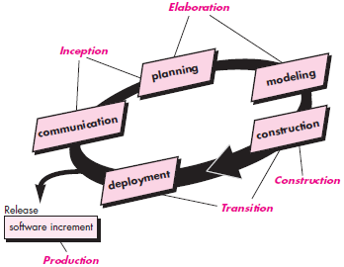
Unit 2: Process Models
The Unified Process:
The Unified Software Development Process or Unified Process is an iterative and incremental software development process framework.
Five Phases of Unified process:
Inception
Elaboration
Construction
Transition
Production

Slide 23


